Slide 1
Yelp Sentiment Analysis
Term project presentation
CS777 Big Data Analytics
Assiya Karatay karatay@bu.edu
Euiyoung Lee euiylee@bu.edu

Slide 2
Agenda
Data Description
Project Goal
Data Preprocessing
Data Visualization
Feature Extraction and Selection
Model Comparison
Results
Google Cloud Notes
Conclusion

Slide 3
Dataset & Objectives
Dataset from Yelp
7M rows, 9 columns
Project goal: build classification models to predict customers’ underlying sentiment in text reviews.

Slide 4
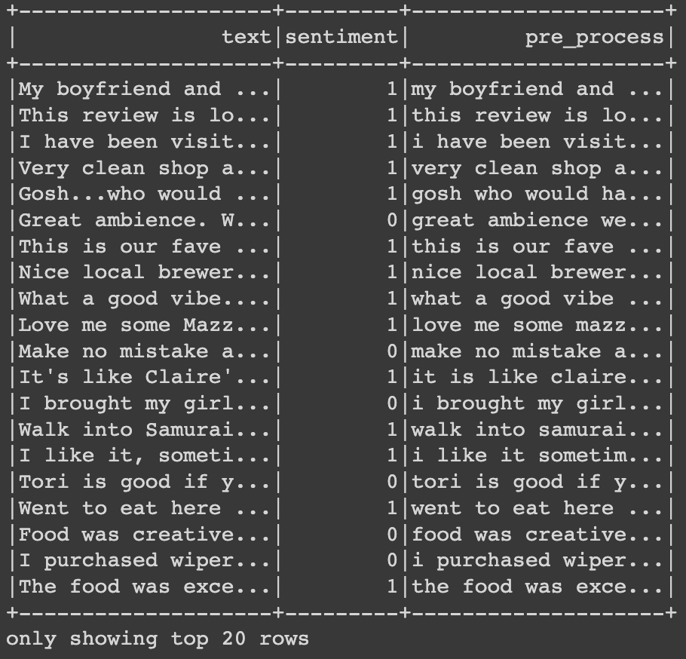
Data preprocessing
Assumption:
Stars less than 4: negative sentiment
Stars more than or equal to 4: positive sentiment
Converted every letter to lowercase
Expanded contractions
(eg. didn’t -> did not, she’s -> she has )
Removed non-alphabetic characters
Punctuations

Slide 5
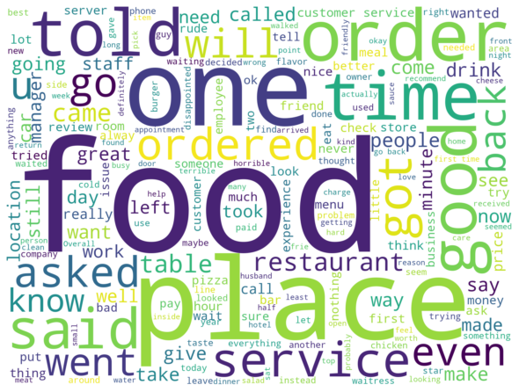
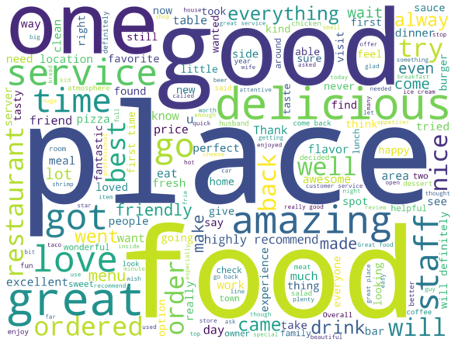
Data Visualization
Negative Sentiment (Star ratings 1-3)
Positive Sentiment (Star ratings 4-5)

Slide 6
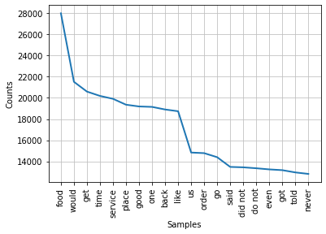
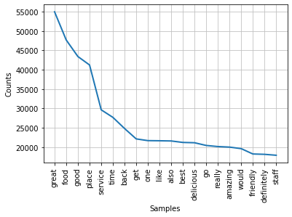
Data Visualization
Negative Sentiment (Star ratings 1-3)
Positive Sentiment (Star ratings 4-5)

Slide 7
Feature Extraction and Selection
Divide into training and testing sets. ​​We used 0.8/0.2 proportion for small data and 0.99, 0.01 for large dataset.
pipeline = Pipeline(stages=[tokenizer, hashtf or CountVectorizer, idf, label_stringIdx,model])
TF maps a sequence of terms to their term frequencies
IDF weights features which appear frequently in a corpus
CountVectorizer will select the top vocabSize words ordered by term frequency across the corpus
The output will consist of a sequence of n-grams where each n-gram is represented by a space-delimited string of consecutive words.
16,000 features from unigram, bigram, trigram gives 48,000 features in total. Compared Chi-Squared feature selection and manual selection to reduce the number of features to 16,000 in total.

Slide 8
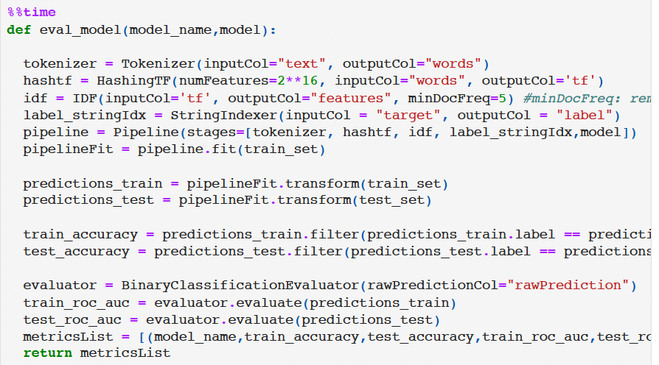
Model
lr = LogisticRegression(maxIter=100)
lsvc = LinearSVC(maxIter=10, regParam=0.1)
dt = DecisionTreeClassifier()

Slide 9
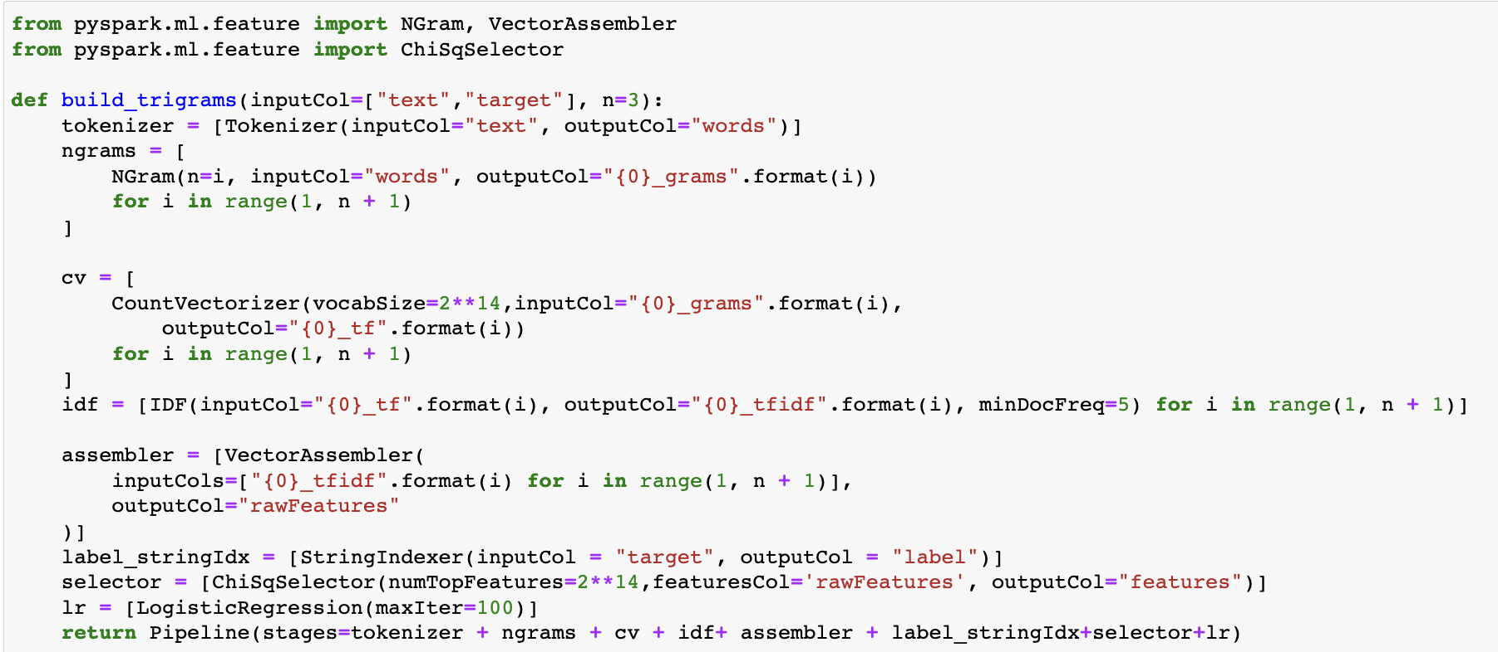
N-gram Implementation with Chi Squared Selector
Spark does not automatically combine features from different n-grams, so I had to use VectorAssembler in the pipeline, to combine the features I get from each n-grams.
I first tried to extract around 16,000 features from unigram, bigram, trigram. This means I will get around 48,000 features in total. Then I implemented Chi Squared feature selection to reduce the features back to 16,000 in total.

Slide 10
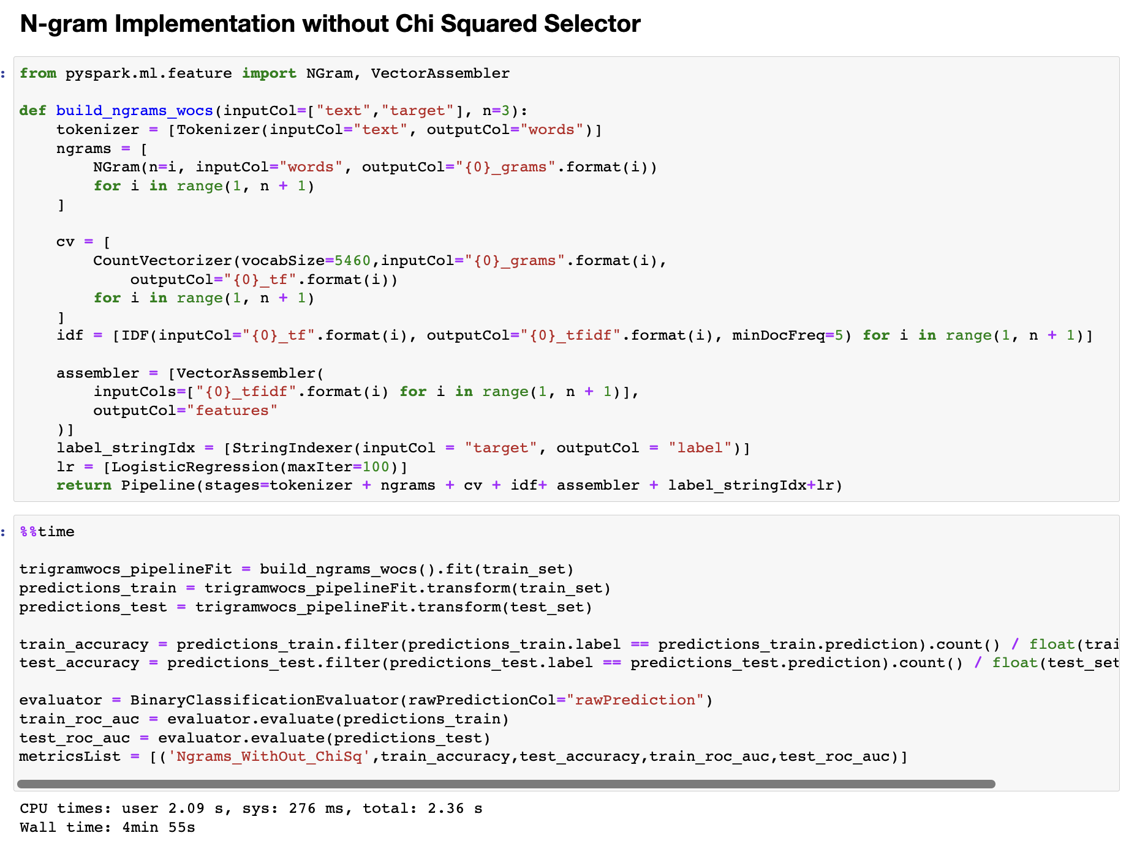

Slide 11
Model Comparison
Logistic regression vs SVM
SVM can handle non-linear solutions whereas logistic regression can only handle linear solutions. Linear SVM handles outliers better, as it derives maximum margin solution. Hinge loss in SVM outperforms log loss in LR. Logistic Regression vs Decision Tree
Decision tree handles colinearity better than LR. Decision trees cannot derive the significance of features, but LR can. Decision trees are better for categorical values than LR.
Decision tree vs SVM
SVM uses kernel trick to solve non-linear problems whereas decision trees derive hyper-rectangles in input space to solve the problem. Decision trees are better for categorical data and it deals colinearity better than SVM.

Slide 12
Results
 | model | train_accuracy | test_accuracy | train_ROC_AUC | test_ROC_AUC | Execution Time
0 | LogReg | 0.9999643 | 0.8167862 | 0.9999995 | 0.8584581 | 2min 3s
1 | LinearSVC | 0.9407043 | 0.90164995 | 0.97813654 | 0.94934887 | 1min 7s
2 | Decision Tree | 0.76986337 | 0.77245337 | 0.6773023 | 0.6837623 | 6min 39s
3 | CVIDF_LogReg | 0.9999643 | 0.8235294 | 0.9999992 | 0.8653524 | 1min 14s
4 | Ngrams_ChiSqSelector_LogReg | 0.9999465 | 0.8776901 | 0.99999934 | 0.92885864 | 6min 15s
5 | Ngrams_WithOut_ChiSq_LogReg | 0.9999822 | 0.87439024 | 0.99999946 | 0.9283303 | 1min 39s
LinearSVC demonstrated the highest test accuracy and area under the ROC curve.
Logistic regression with all feature selection combinations illustrated overtraining with high training accuracy and ROC AUC values.
The Decision Tree showed the worst results among all models.

Slide 13
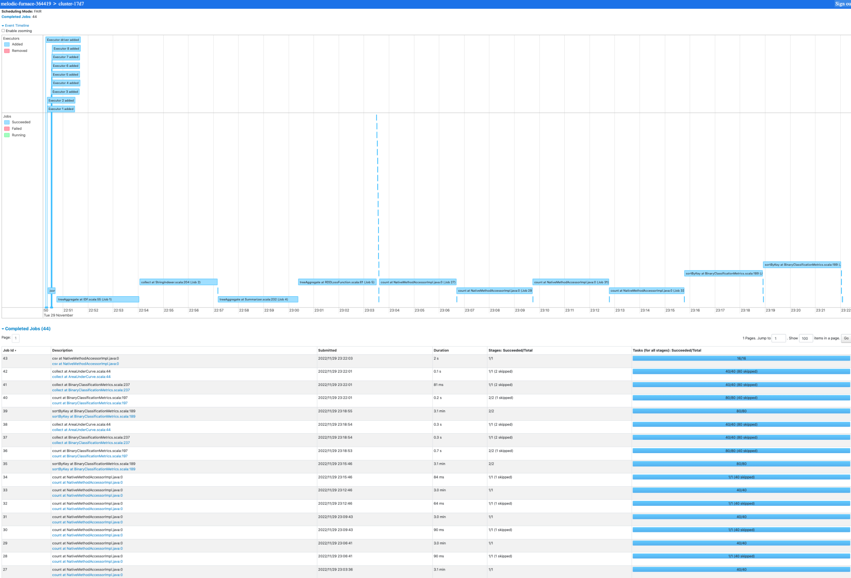
Results
Model: Linear SVC
Train accuracy: 0.94425613
Test accuracy: 0.91141141
Train ROC AUC: 0.98025741
Test ROC AUC: 0.95481465
Execution Time: 1 hour 32 min 1s

Slide 14
Google Cloud Notes
During the creation of a cluster, we need to add shell command in initialization tab to install Python Spacy and Contractions libraries that are used for preprocessing.
The large data is saved in multi-region Cloud Storage.

Slide 15
Conclusion
We processed and performed Exploratory Data Analysis for Yelp Reviews. This data has all business areas including restaurants, health care systems, and others.
We compared Logistic Regression, Linear Support Vector Machines for Classification, and Decision Tree.
We analyzed three different feature extraction and selection model combinations such as hashing TF and IDF, count vectorizer and IDF, n-gram,count vectorizer and IDF.
We achieved 91% testing accuracy on our chosen model Linear Support Vector Machines for Classification and 0.95 Area under ROC curve, which shows the trade-off between sensitivity and specificity.
We learned Spark ML models training, testing, evaluation and data management on a cluster.
We handled library initialization and some cluster errors, which improved our model deployment technical skills.

Slide 16
Thank you!

